Slide 1
Lesson 12 Security & ethical issues
Textbook: Chapter 16 & 20

Slide 2
Objectives
LO12: Describe security goals and discuss ethical issues
Define security goals—confidentiality, integrity, and availability.
Show how confidentiality can be achieved using symmetric-key and asymmetric-key cipher.
Discuss other aspects of security: message integrity, message authentication, digital signature, entity authentication, and key management.
Discuss the use of Firewalls to protect a system from harmful message.
Define three ethical principles related to the use of computers.
Distinguish between physical and intellectual properties.
Define privacy as related to the use of computers.
Define hackers and the damages done by them.

Slide 3
Contents
1. Introduction
2. Confidentiality
3. Other aspects of security
4. Firewalls
5. Ethical Principles
6- Intellectual Properties
7. Privacy
8. Hackers

Slide 4
1- Introduction to Security
We are living in the information age.
Information are private assets (tài sản) →
They need to be secured from attacks → they need to be hidden from unauthorized access (confidentiality), protected from unauthorized change (integrity), and available to an authorized entity when it is needed (availability).
We need confidentiality in storing, maintain, transmission private data.

Slide 5
Introduction to Security…
3 main security goals
No. | Goal | Description
1 | Confidentiality | keeping information secret from unauthorized access
2 | Integrity | changes should be done only by authorized users and through authorized mechanisms
3 | Availability | Information is useful only when they are available.

Slide 6
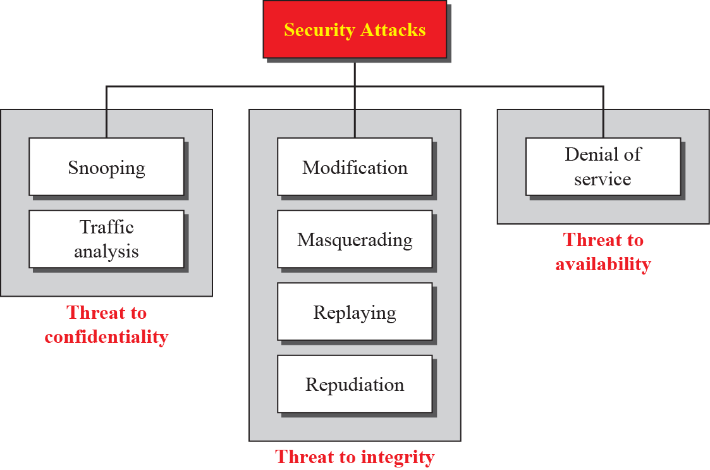
Introduction to Security…
Attacks: Forms
Figure 16.1 Taxonomy of attacks with relation to security goals
Snooping (rình) refers to unauthorized access to or interception (chặn) of data
Traffic analysis for collecting information .
Notes:
Threat: mối đe dọa
Snooping: rình mò
Masquerade giả danh
Repudiation: bác bỏ

Slide 7
Introduction to Security…
Services and Techniques
ITU-T: International Telecommunication Union - Telecommunication Standardization Sector.
ITU is is a specialized agency of the United Nations responsible for all matters related to information and communication technologies.
ITU-T defines some security services to achieve security goals and prevent attacks. Each of these services is designed to prevent one or more attacks while maintaining security goals. The actual implementation of security goals needs some techniques.
Two techniques are prevalent (widespread) today:
One is specific (steganography- che dấu nội dung chính (ngắn) trong một nội dung khác (dài hơn) ).
One is very general (cryptography – mã hóa)

Slide 8
Introduction to Security…
Steganography – Kỹ thuật giấu nội dung
It was in the past is being revived at the present time.
The content is concealed (che đây)/covered in a larger content.
Steganography (origin in Greek) means ‘covered writing’.
Ex: “Apparently neutral’s protest is thoroughly discounted and ignored. Isman hard hit. Blockade issue affects for pretext embargo on by-products, ejecting suets and vegetable oils.”
Getting the 2nd character in words, we have:
“Pershing sails for NY June 1”

Slide 9
Introduction to Security…
Cryptography – mật mã học
Cryptography, a word with Greek origins, means “secret writing”. However, we use the term to refer to the science and art of transforming messages to make them secure and immune (miễn dịch) to attacks.
Although in the past cryptography referred only to the encryption and decryption of messages using secret keys, today it is defined as involving three distinct mechanisms:
symmetric-key encipherment (mã hóa đối xứng),
asymmetric-key encipherment, and
Hashing.
Encryption: C = E_{k}(P) Decryption: P = D_{k}(C)

Slide 10
2- Confidentiality
It is the first goal of security, confidentiality.
Confidentiality can be achieved using ciphers.
Ciphers can be divided into two broad categories:
Symmetric-key: Input is a symbol, output is a symbol, using the same key for shift right/left to encoding/decoding
Asymmetric-key : Input is number, output is number, using a key to encoding and another to decoding. Information about receiver (receiver’s signature) may be encoded and transmitted together with encoded data to receiver.

Slide 11
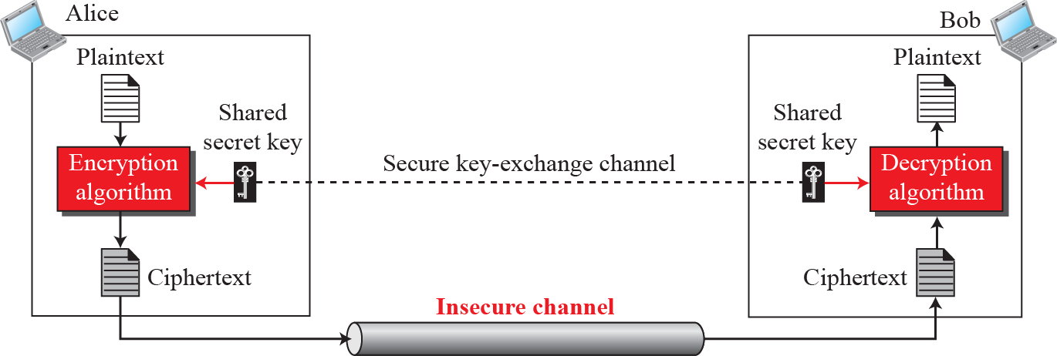
Confidentiality…
Symmetric-key Ciphers
Using the same key for both encryption and decryption →symmetric.
They are called as secrete-key ciphers also.
Encryption: C = E_{k}(P) Decryption: P = D_{k}(C)
Figure 16.2 General idea of symmetric-key cipher
P
P
C
C

Slide 12
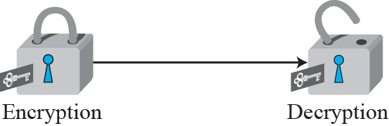
Confidentiality…
Symmetric-key Ciphers
Encryption can be thought of as locking the message in a box; decryption can be thought of as unlocking the box.
In symmetric-key encipherment, the same key locks and unlocks.
Figure 16.3 Locking and unlocking with the same key

Slide 13
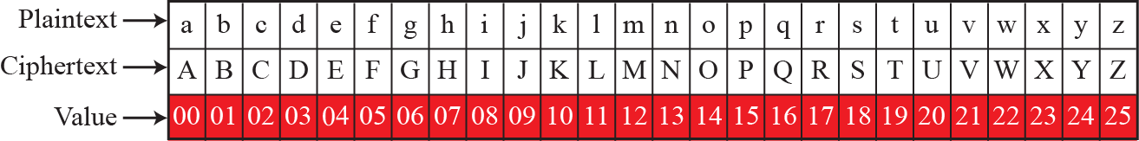
Confidentiality…
Symmetric-key Ciphers/ Traditional methods: Substitution ciphers
Traditional ciphers belong to the past. However, we briefly discuss them here because they can be thought of as the components of the modern ciphers. To be more exact, we can divide traditional ciphers into
substitution ciphers: Replacing one symbol with another ← Shifting
transposition ciphers: Reorder symbols ← Changing order of symbols
Figure 16.4 Representation of plaintext and ciphertext in modulo 26
A substitution cipher example. Keys: integers in modulo 26

Slide 14
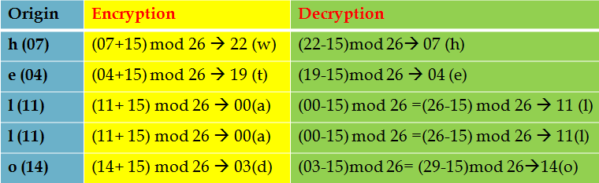
Confidentiality…
Symmetric-key Ciphers/Traditional methods : Substitution ciphers
Example 16.1, 16.2: Additive cipher: E (char, key) = (char+key) mod 26
P (char, key) = (char-key) mod 26
Use the additive cipher with key = 15 to encrypt the message “hello” then decrypt the ciphertext.
Solution: Character a: 00 → h: 07
“hello” → “wtaad” → “hello”

Slide 15
Confidentiality…
Symmetric-key Ciphers/Traditional methods: Substitution ciphers
Polyalphabetic cipher, each occurrence of a character may have a different substitute → variabale keys. Example:
‘a’ could be enciphered as ‘D’ at the beginning of the text
‘a’ could be enciphered as ‘N’ in the middle.
….
Autokey cipher cipher in which the key is a stream of agreed subkeys. Each subkey is used to encrypt the corresponding character in the plaintext.

Slide 16
Confidentiality…
Symmetric-key Ciphers/Traditional methods: Substitution ciphers
Example 16.3 – An Autokey cipher.
Assume that Alice and Bob agreed to use an autokey cipher with initial key value k1 = 12. Now Alice wants to send Bob the message ‘Attack is today’. Enciphering is done character by character. Each character in the plaintext is first replaced by its integer value. The first subkey is added to create the first ciphertext character. The rest of the key is created as the plaintext characters are read. Note that the cipher is polyalphabetic because the three occurrences of ‘a’ in the plaintext are encrypted differently. The three occurrences of ‘t’ are encrypted differently.
Plaintext: a t t a c k i s t o d a y
P’s Values: 00 19 19 00 02 10 08 18 19 14 03 00 24
Key stream: 12 00 19 19 00 02 10 08 18 19 14 03 00
C’s Values: 12 19 12 19 02 12 18 00 11 7 17 03 24
Ciphertext: M T M T C M S A L H R D Y

Slide 17
Confidentiality…
Symmetric-key Ciphers/Traditional methods: Transposition ciphers
Transposition cipher reorders symbols
A transposition cipher does not substitute one symbol for another; instead it changes the location of the symbols.
Ex:
A first symbol of the plaintext may appear in the tenth position of the ciphertext.
A eighth symbol in in the plaintext may appear in the first position of the ciphertext.

Slide 18
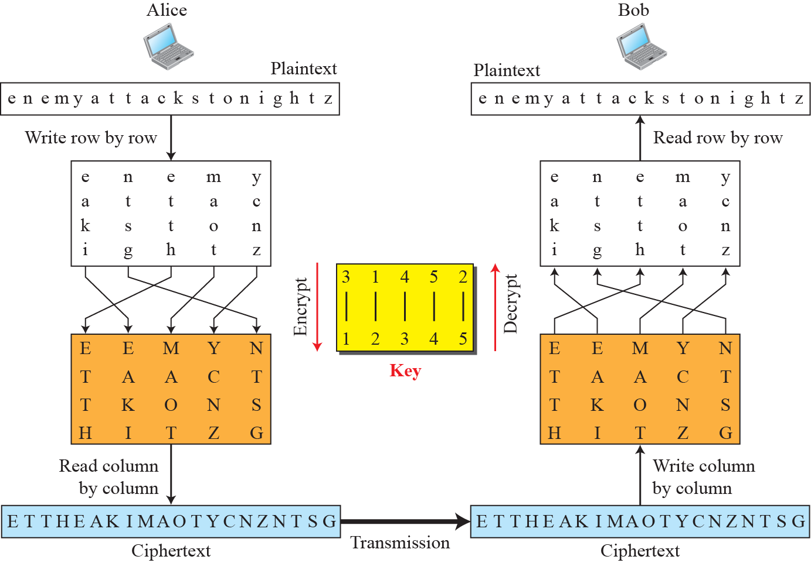
Confidentiality…
Symmetric-key Ciphers/Traditional methods: Transposition ciphers
Figure 16.5 Transposition cipher

Slide 19
Confidentiality…
Symmetric-key Ciphers/Traditional methods: Transposition ciphers
Stream and block ciphers: Modern symmetric-key ciphers
The literature divides the symmetric ciphers into two broad categories: stream ciphers and block ciphers.
Stream cipher: Encryption and decryption are done one symbol (such as a character or a bit) at a time. We have a plaintext stream, a ciphertext stream, and a key stream. Call the plaintext stream P, the ciphertext stream C, and the key stream K.
P = P₁P₂P₃, … C = C₁C₂C_{3,} … K = (k₁, k₂, k₃, …)
C1 = E_{k1}(P1) C2 = E_{k2}(P2) C3 = E_{k3}(P3) …

Slide 20
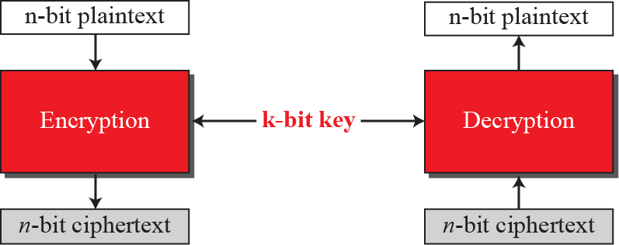
Confidentiality…
Symmetric-key Ciphers/Traditional methods: Transposition ciphers
Stream and block ciphers: Modern symmetric-key ciphers
Block cipher A symmetric-key modern block cipher encrypts an n-bit block of plaintext or decrypts an n-bit block of ciphertext. The encryption or decryption algorithm uses a k-bit key.
The decryption algorithm must be the inverse of the encryption algorithm, and both operations must use the same secret key.
Figure 16.6 A modern block cipher

Slide 21
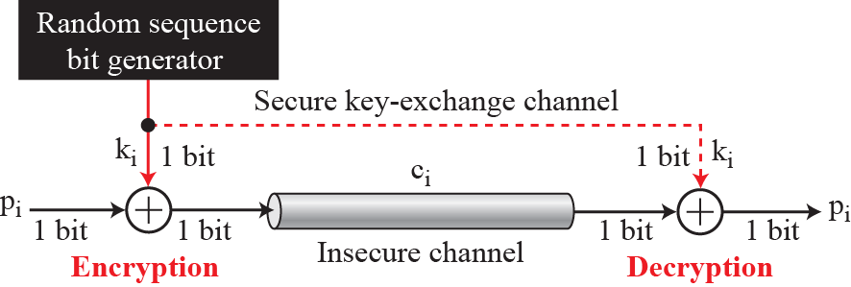
Confidentiality…
Symmetric-key Ciphers/Traditional methods: Transposition ciphers
Stream and block ciphers: Modern symmetric-key ciphers
The simplest and the most secure type of synchronous stream cipher is called the one-time pad (OTP- mật khẩu sử dụng 1 lần), which was invented and patented by Gilbert Vernam.
Figure 16.7 One-time pad (OTP)

Slide 22
Confidentiality…
Asymmetric-key ciphers
Symmetric-key cryptography is based on sharing secrecy;
Asymmetric-key cryptography is based on personal secrecy.
In symmetric-key cryptography, the secret must be shared between two persons ( using the same key).
In asymmetric-key cryptography, the secret is personal (unshared); each person creates and keeps his/her own secret.
In a community of n people:
Symmetric-key cryptography needs n (n - 1)/2 shared secrets.
Asymmetric-key cryptography needs n personal secrets only.
Person | 1 | 2 | 3 | … | n-1 | n
Connection | (n-1) | (n-2) | (n-3) | … | 1 | 0
No. of connection s | (n-1) + (n-2) +(n-3) + … + 3 + 2 + 1 = (n-1+1) (n-1)/2 = n(n-1)/2

Slide 23
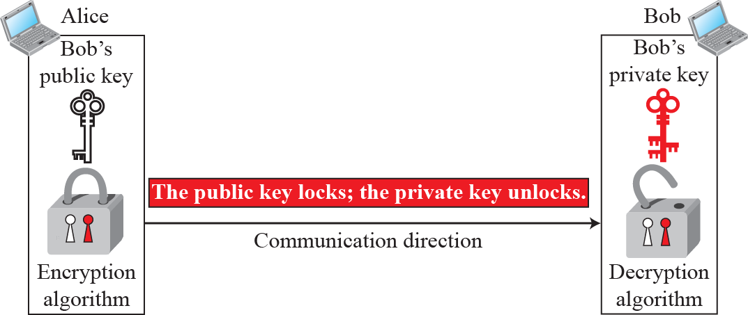
Confidentiality…
Asymmetric-key ciphers
Symmetric-key cryptography is based on substitution and permutation of symbols (characters or bits): symbol ←→ symbol.
Asymmetric-key cryptography is based on applying mathematical functions to numbers, data are behaved as numbers: number ←→ number.
Figure 16.8 Locking and unlocking in asymmetric-key cryptography
Asymmetric-key is called as public-key ciphers.

Slide 24
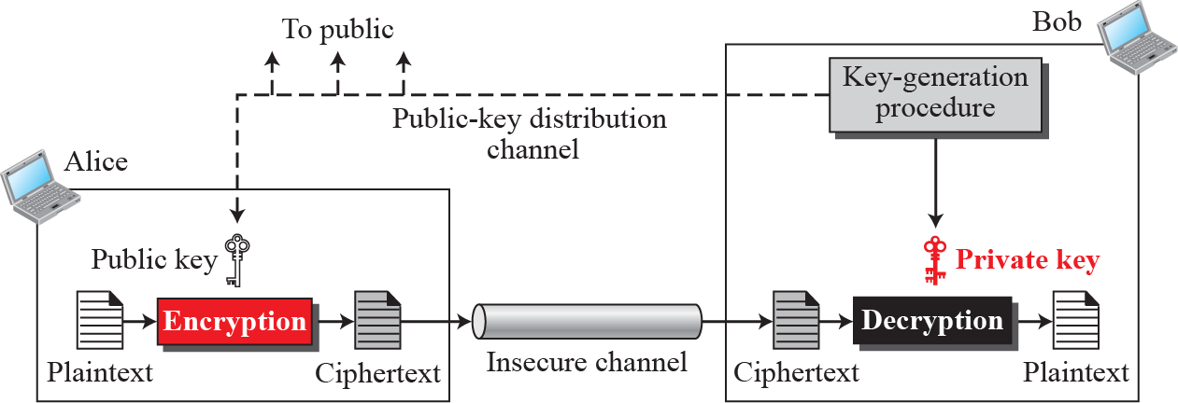
Confidentiality…
Asymmetric-key ciphers
Figure 16.9 General idea of asymmetric-key cryptography
Asymmetric-key cryptography is normally used to encrypt
or decrypt small pieces of information..

Slide 25
Confidentiality…
Asymmetric-key ciphers: RSA crypto-system
- Although there are several asymmetric-key cryptosystems, one of the common public-key algorithms is the RSA cryptosystem, named for its inventors (Rivest, Shamir, and Adleman).
RSA uses two exponents, e and d, where e is public and d is private.
Sender uses C = P^{e} mod n to create cipher symbol from plaintext P;
Receiver uses P = C^{d} mod n to decode cipher symbol.
How to determine public key e and private key d?

Slide 26
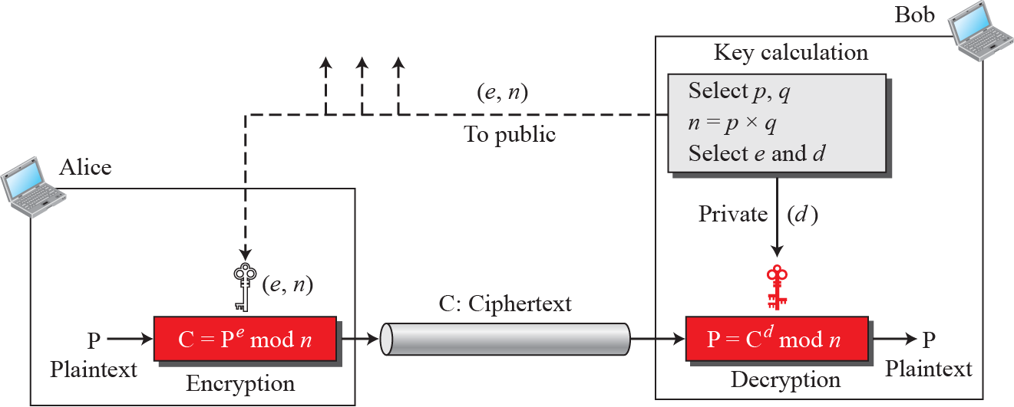
Confidentiality…
Asymmetric-key ciphers: RSA crypto-system
RSA algorithm demo:
Next slide.
p, q, n are very large integers and they are used during the key generation process.
Figure 16.10 Encryption, decryption, and key generation in RSA

Slide 27
Confidentiality…
Asymmetric-key ciphers: RSA crypto-system
RSA Algorithm Demo.:
Example 16.4
Step | Action | Example
1 | Choose 2 integers P and Q | P=7, Q=11
2 | Calculate N= PQ | N= 7 x 11 = 77
3 | Calculate (N) = (P-1)(Q-1) | (N) = (7-1)(11-1) = 60
4 | Choose E, 1<E< (N) and (E, (N)) are relative primes (greatest common divisor =1) | Choose E= 13
5 | Calculate modulo inversion, D, of E DE = 1(mod (f(N)) | D = 37 (13x37) mode 60 → 1
Result:
E=13, N= 77 → public key
D = 37 → Private key
Plain text: 5 → C= 5¹³ mod 77 = 26 ← Cipher text
Cipher text 26 → 26³⁷ mod 77 = 5 ← Plain text
With P and Q are small, the system is not safe

Slide 28
Confidentiality…
Asymmetric-key ciphers: RSA crypto-system
Example 16.5 – Realistic example in Java
Choosing 512-bit p and q, and calculate n and f(n).
We then choose e and calculate d.
Finally, we show the results of encryption and decryption. The integer p is a 159-digit number.
p = 9613034531358350457419158128061542790930984559499 6215822583
15087964794045505647063849125716018034750312098666606492420
191808780667421096063354219926661209
q = 12060191957231446918276794204450896001555925054637033936061
79832173148214848376465921538945320917522527322683010712069
5604602513887145524969000359660045617
n = 115935041739676149688925098646158875237714573754541447754855
261376147885408326350817276878815968325168468849300625485764
11125016241455233918292716250765677272746009708271412773043
49605005563472745666280600999240371029914244722922157727985
317270338393813346926841373276220009666766718318310883734208
23444370953

Slide 29
Confidentiality…
Asymmetric-key ciphers: RSA crypto-system
Example 16.5 – Realistic example in Java
F(n)= 11593504173967614968892509864615887523771457375454144775485526137
61478854083263508172768788159683251684688493006254857641112501624
14552339182927162507656751054233608492916752034482627988117554787
65701392344440571698958172819609822636107546721186461217135910735
8640614008885170265377277264467341066243857664128
e = 35535
d = 580083028600377639360936612896779175946690620896509621804228661113
805938528223587317062869100300217108590443384021707298690876006115
306202524959884448047568240966247081485817130463240644077704833134
010850947385295645071936774061197326557424237217617674620776371642
0760033708533328853214470885955136670294831
P = 1907081826081826002619041819
C = 47530912364622682720636555061054518094237179607049171652323924305
44529606131993285666178434183591141511974112520056829797945717360
36101278218847892741566090480023507190715277185914975188465888632
10114835410336165789846796838676373376577746562507928052114814184
404814184430812773059004692874248559166462108656

Slide 30
Confidentiality…
Asymmetric-key ciphers: RSA crypto-system
RSA Applications
Although RSA can be used to encrypt and decrypt actual messages, it is very slow if the message is long. RSA, therefore, is useful for short messages. In particular, we will see that RSA is used in digital signatures and other cryptosystems that often need to encrypt a small message without having access to a symmetric key. RSA is also used for authentication, as we will see later in the chapter.

Slide 31
3- Other Aspects of Security
Except confidentiality, we need to take care of other aspects of security, such as
Integrity: the message should remain unchanged ← Testing
- Message and entity authentication ← Authentication checking
Non-repudiation, - chống chối bỏ hợp đồng ← Use service provider
Key management ← Use service provider

Slide 32
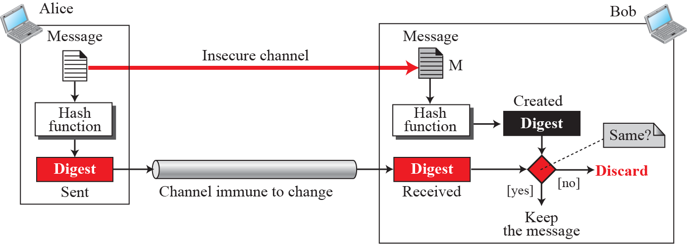
Other Aspects of Security…
Message integrity: Message and message digest
Using fingerprint including the message and digest pair. To preserve the integrity of a message, the message is passed through an algorithm called a cryptographic hash function (mã hóa băm).
H1: arbitrary length input → fixed length digest.
H2: fixed-size n-bit input → fixed-size m-bit digest, n>m (compressed)
- Digest: compressed, encrypted bit string
Figure 16.11 Message and digest

Slide 33
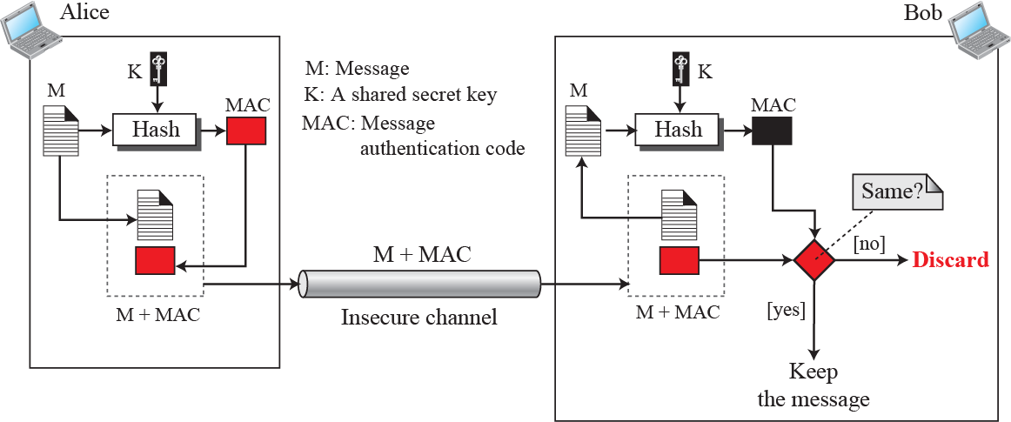
Other Aspects of Security…
Message authentication
A process on message owner to create a message authentication code (MAC)
Figure 16.12 Signing the digest
A MAC provides message integrity and message authentication using a combination of a hash function and a secret key.
The National Institute of Standards and Technology (NIST) issued a standard for a nested MAC that is often referred to as HMAC (hashed MAC)→ It is not introduced in this text.

Slide 34
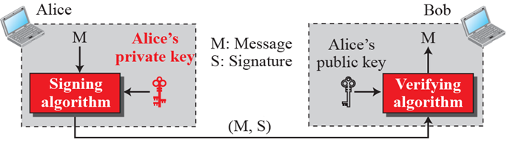
Other Aspects of Security…
Message authentication: Digital signature
- In some more security services, digital signature is used. A MAC uses a secret key to protect the digest; a digital signature uses a pair of private–public keys.
- A cryptosystem uses the private and public keys of the receiver;
a digital signature uses the private and public keys of the sender.
- A digital signature needs a public-key system. The signer signs with her private key; the verifier verifies with the signer’s public key.
Figure 16.13 Digital signature process

Slide 35
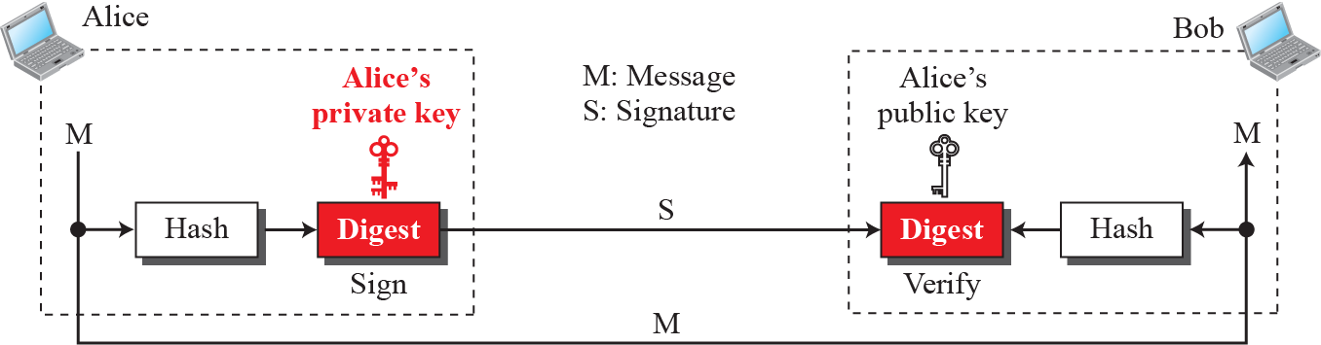
Other Aspects of Security…
Message authentication: Signing the digest
- Hashing long message to shorter digest, sender signs on the digest, receiver verified the received digest.
Figure 16.14 Signing the digest

Slide 36
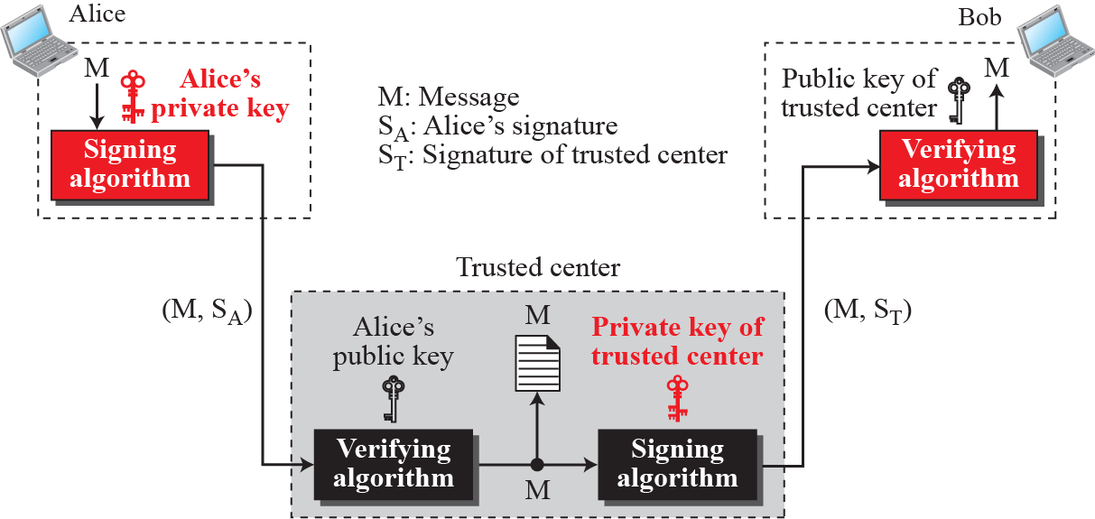
Other Aspects of Security…
Services from Trusted Center
Trusted Center supports all needed security tools.
Figure 16.15 Using a trusted center for nonrepudiation
https://neac.gov.vn/

Slide 37
Other Aspects of Security…
Entity authentication- Xác thực chủ thể
Entity/user identity | Account (public) + password (private) | Normal use
 | Question (public) – Answer (private) related to user such as something known, something possessed, or something inherent.. | In case of password is omitted.
Entity authentication is a technique designed to let one party (nhóm thành v iên) verify the identity of another party.
An entity can be a person, a process, a client, or a server.
The entity whose identity (dữ liệu nhận dạng) needs to be proven is called the claimant (chủ thể cần được xác thực).
The party that tries to verify the identity of the claimant is called the verifier (người kiểm tra).

Slide 38
Other Aspects of Security…
Entity authentication versus Message authentication
Log in
Send
message 1
Send
message 2
Send
message 3
Log out
time
session
There are two differences between entity authentication and message authentication (data-origin authentication).
Message authentication (or data-origin authentication) might not happen in real time; entity authentication does.
Message authentication simply authenticates one message; the process needs to be repeated for each new message. Entity authentication authenticates the claimant for the entire duration of a session.

Slide 39
Other Aspects of Security…
Entity authentication: Password
An entity is usually identify by <account, password>
The simplest and oldest method of entity authentication (claimant).
A password is used when a user needs to access a system’s resources (login).
Passwords are very prone to attack/ can be stolen/ intercepted (chặn)/ guessed (đoán), …
In some cases, extra data are added such as one-time password OTP.

Slide 40
Other Aspects of Security…
Entity authentication: Challenge -response
In case of high security is needed, an entity is usually identify by <account, password> + challenge – response authentication.
Challenge: an one-time small data (random number/characters, called as nonce- number once), short lifetime will be sent to claimant from verifier.
Response: encrypted data from claimant is sent to verifier as a respond.
It is called as OTP (one-time pad, one-time password). It is valid for only one login session.

Slide 41
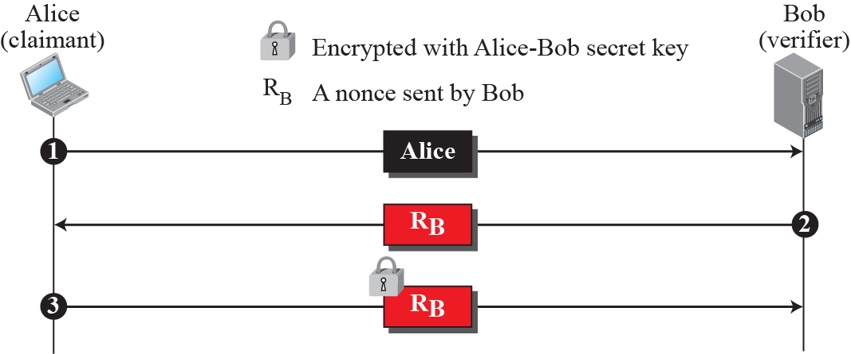
Other Aspects of Security…
Entity authentication: Challenge -response
Figure 16.16 Unidirectional, symmetric-key authentication
Server
R_{B1} = RB₂ → Valid

Slide 42
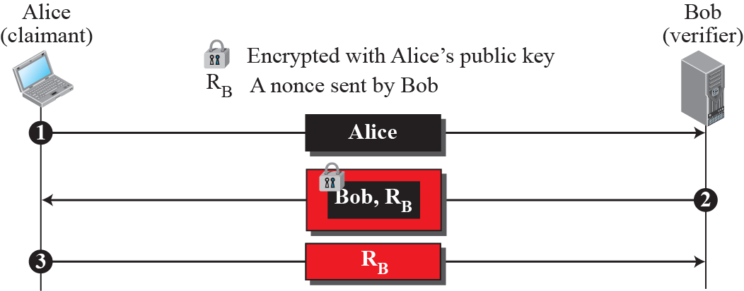
Other Aspects of Security…
Entity authentication: Challenge -response
Figure 16.17 Unidirectional, asymmetric-key authentication
Server
R_{B1} = RB₂ → Valid

Slide 43
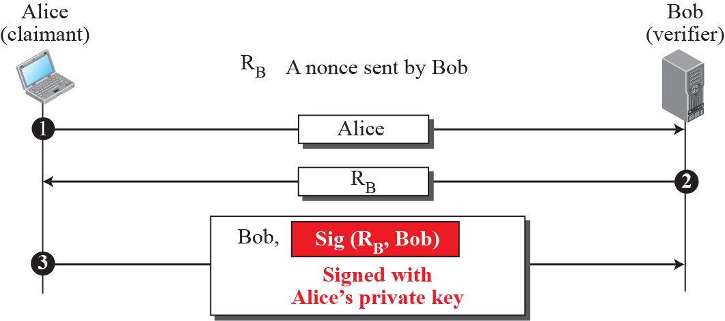
Other Aspects of Security…
Entity authentication: Challenge -response
Figure 16.18 Digital signature, unidirectional authentication
Server
R_{B1} = RB₂ And
Bob1 = Bob2
→ Valid

Slide 44
Other Aspects of Security…
Key management
How to distribute and maintain secret keys?
Symmetric-key distribution
Advantage: Symmetric-key cryptography is more efficient than asymmetric-key cryptography for enciphering large messages.
Disadvantage: Symmetric-key cryptography needs a shared secret key between two parties.
Key Distribution centers are needed.

Slide 45
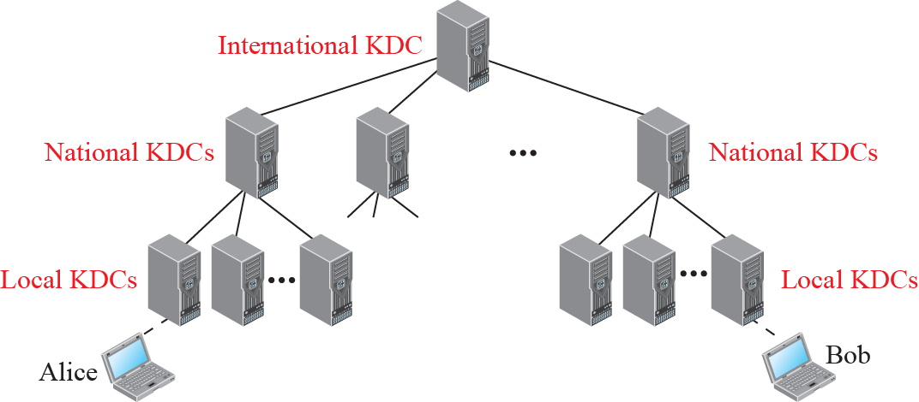
Other Aspects of Security…
Key management
Figure 16.19 Multiple Key Distribution Centers (KDCs)

Slide 46
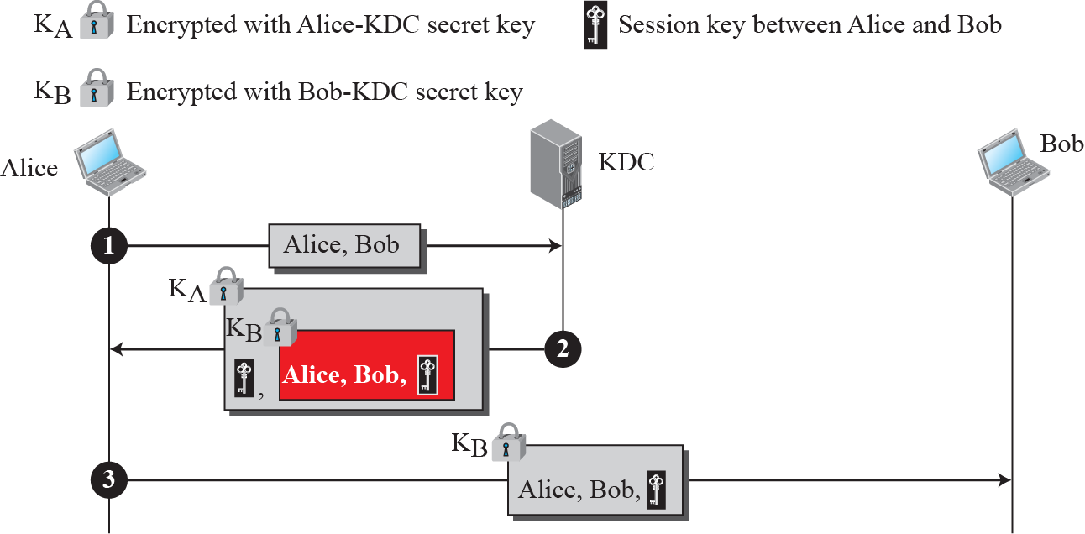
Other Aspects of Security…
Key management
Figure 16.20 Creating a session key using KDC

Slide 47
Other Aspects of Security…
Key management
Public-key distribution
In asymmetric-key cryptography, if Alice wants to send a message to Bob, she only needs to know Bob’s public key, which is open to the public and available to everyone. If Bob needs to send a message to Alice, he only needs to know Alice’s public key, which is also known to everyone. In public-key cryptography, everyone shields a private key and advertises a public key.

Slide 48
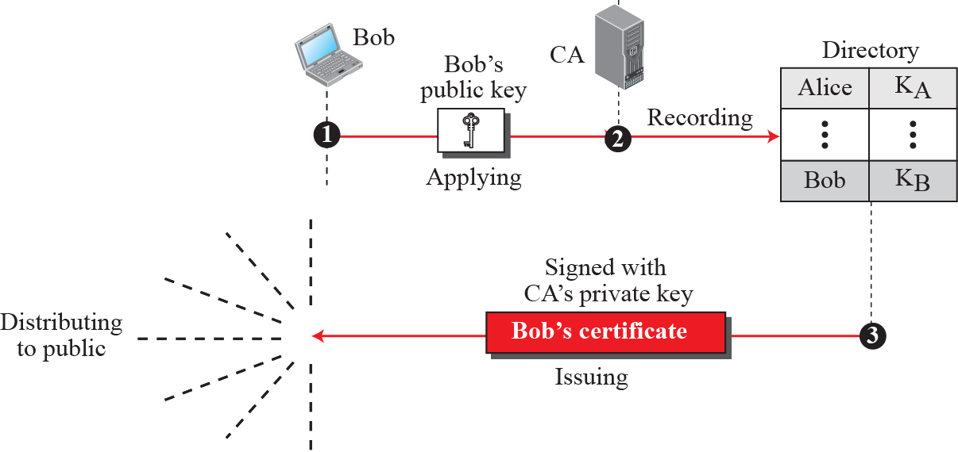
Other Aspects of Security…
Key management
Figure 16.21 Certification authority

Slide 49
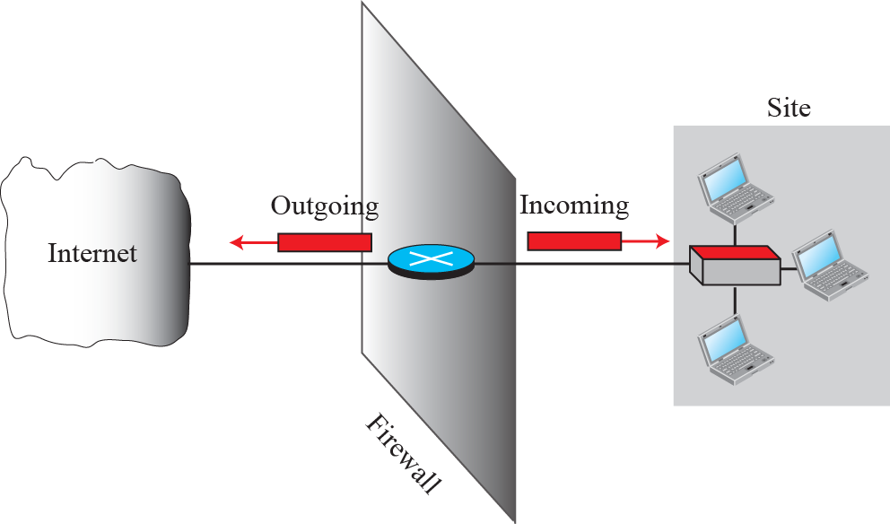
4- Firewalls
To control access to a system we need firewalls.
A firewall is a device (usually a router or a computer) installed between the internal network of an organization and the rest of the Internet.
Figure 16.22 General idea of symmetric-key cipher
It is designed to forward some packets and filter (not forward) others

Slide 50
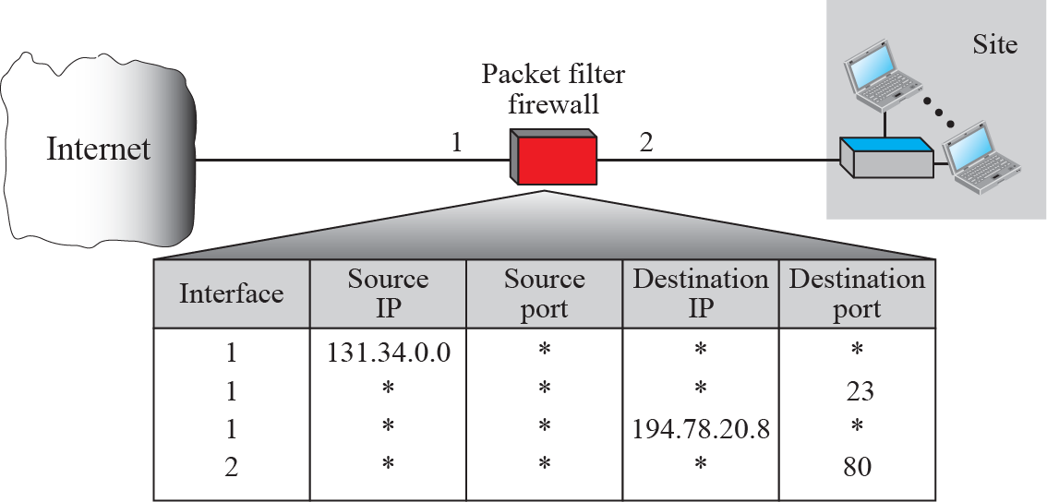
Firewalls…
Packet filter firewall
A firewall can be used as a packet filter based on the information in the network-layer and transport-layer headers: source and destination IP addresses, source and destination port addresses, and type of protocol (TCP or UDP).
Figure 16.23 Packet-filter firewall
A packet-filter firewall is a router that uses a filtering table to decide which packets must be discarded .

Slide 51
Firewalls…
Proxy firewall
The packet-filter firewall is based on the information available in the network-layer and transport-layer headers (IP and TCP/UDP). However, sometimes we need to filter a message based on the information available in the message itself (at the application layer).
A proxy firewall stands between the customer computer and the corporation computer. When the user client process sends a message, the application gateway runs a server process to receive the request. The server opens the packet at the application level and finds out if the request is legitimate (legal). If it is, the server acts as a client process and sends the message to the real server in the corporation. If it is not, the message is dropped and an error message is sent to the external user. Figure 16.24 shows a HTTP proxy firewall.

Slide 52
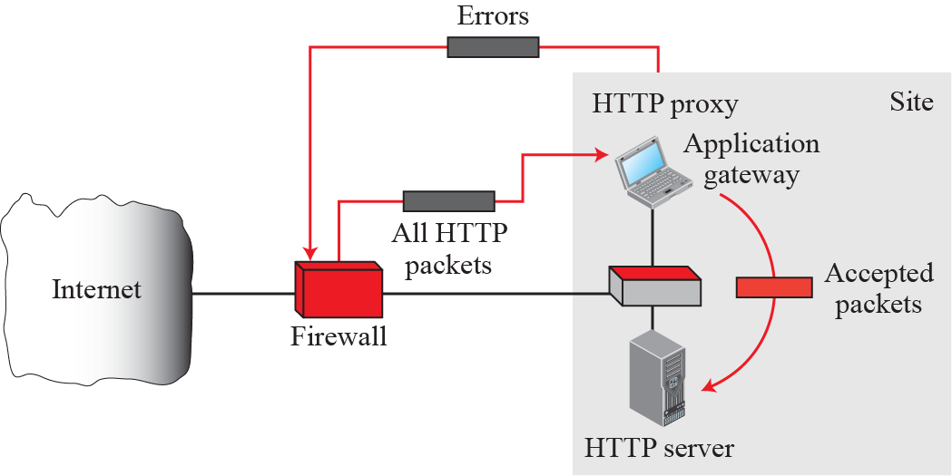
Firewalls…
Proxy firewall
Figure 16.24 Proxy firewall
Checking whether the request is legitimate?
Checking package
header

Slide 53
Firewalls Summary
Firewall is a device or a program which plays a role as a filter of our system.
Package firewall filters packages based on their package’s header.
Proxy firewall will check whether a request in each package is legitimate or not.

Slide 54
5- Ethical Principles
Figure 20.1 Three main principles of ethics
The first principle of ethics says that we should avoid doing anything if it is against universal morality .
Moral rule
Ethical
Principles
The second principle of ethics says that an act is ethical if it brings about a good result.
Utilization
Social contract
The third principle of ethics says that an act is ethical if a majority (đa số) of people in society agree with it.

Slide 55
6- Intellectual Properties
2 kinds of properties:
Consideration | Physical property | Intellectual property
Be copied? | No | Yes
Be manufactured? | Yes | Yes
Owner | One person or group | One person or group
After copied |  | Owner is original
Types of Intellectual properties:
Trademarks | A trademark identifies a company’s product or service.
Trade secrets | A trade secret is the information about a product that is kept secret by the owner.
Patents | A patent is a right to a monopoly to use and commercially exploit a piece of intellectual property in a limited period of time.
Copyright | A copyright is a right to a written or created work.

Slide 56
7- Privacy
Some countries introduced codes related to privacy:
No. | Code
1 | Collect only data that are needed.
2 | Be sure that the collected data are accurate.
3 | Allow individuals to know what data have been collected.
4 | Allow individuals to correct the collected data if necessary.
5 | Be sure that collected data are used only for the original purpose.
6 | Use encryption technique to accomplish private communication.

Slide 57
8- Hackers
Hacker is someone who gains unauthorized access to a computer belonging to someone else in order to copy secret information.
* Types of attacks: Refer to the page 528 in the textbook.

Slide 58
Exercises- Use your notebook
Write your reviews to your notebook.
More pages More Scores

Slide 59
Thanks for Following this lesson

